Slide 1
Senior Design Weekly Update
Group may1633
9/28/2015

Slide 2
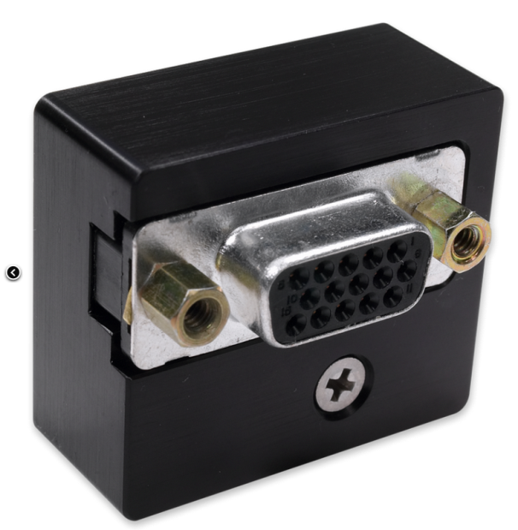
Reasons for choosing USB connection rather than RS232
Directly connect to the spectrometer, RS232 need a “USB-ADP-PC” to connect to the spectrometer, which cost $128
Most microcontrollers have the USB cable, but not RS232 cable

Slide 3
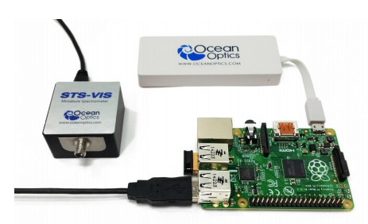
Things need to do for the connection
The micro controller would need to be programmed to trigger the spectrometer.
There is similar project provided by Ocean Optics company

Slide 4
Research for TI Microcontroller
Special Functions and Peripherals for MSP Low-power Microcontrollers

Slide 5
LCD Drivers
Benefits:
Extend battery life and reduce Bill of Materials
Minimize system size with flexible hardware layout

Slide 6
USB Components
Benefits:
Reduce BOM and enable longer battery life
Suited for 99% of USB applications
Enables more USB interfaces in a composite USB device

Slide 7
Wireless Connectivity
External radio frequency
TI offers radios including sub-1GHz, 6LoWPAN, Bluetooth® Smart, Wi-Fi®, NFC™ that pair with TI Low-power MCUs

Slide 8
MSP430F6x/FG6x MCUs

Slide 9
Research for Arduino Uno
Source: https://www.arduino.cc/en/Main/ArduinoBoardUno

Slide 10
Shields
Arduino Uno has many “shields” developed specifically for the board
Bluetooth
LCD
Arduino’s website has many resources for information on building custom shields.

Slide 11
Open-Source Arduino Software
Free IDE for application development.
IDE makes its easy to write code and upload it to the board
Able to view source code from GitHub

Slide 12
Raspberry Pi
From: element14 Raspberry Pi

Slide 13
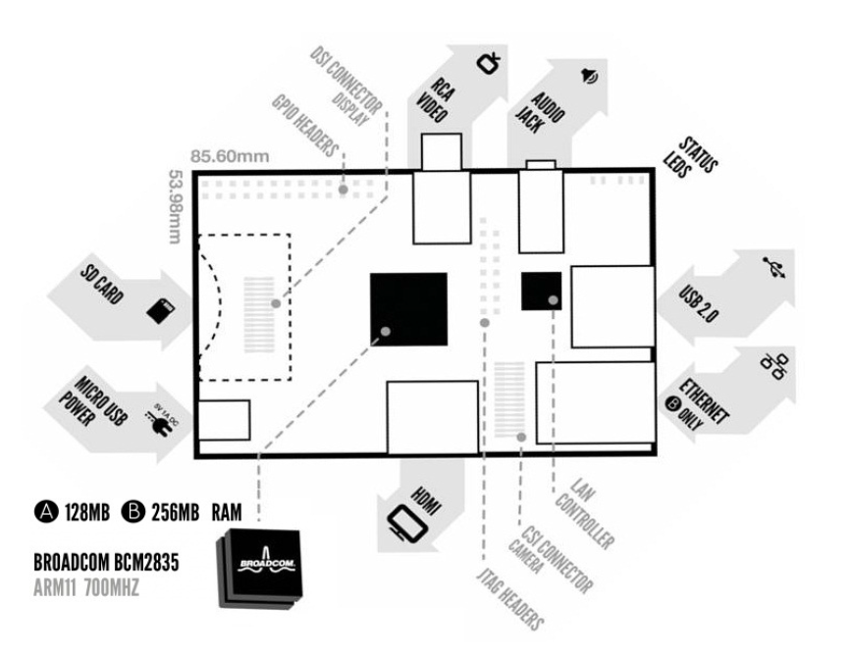
Advantages
Portable (USB2.0, Micro USB power, Ethernet, etc)
From element14 Raspberry Pi datasheet

Slide 14
Advantages
Extra operating system SD card
Raspbian and NOOBS (download available on the website)
Other operating system (Ubuntu mate, snappy Ubuntu core, windows 10 IOT core, etc)
Storage is decidable

Slide 15
Advantages:
Power supply
5V micro USB supply
Current
model B between 700-1000mA depending on what peripherals are connected
model A about 500mA with no peripherals attached
Mobile cell phone battery (in theory, needs confirmation)

Slide 16
Advantages:
Display
800 x 480 RGB LCD display
DSI connector
Connection
Bluetooth module (extra)
RS232 port (extra)
Guidance
Websites and communities to learn

Slide 17
Advantages
Price
$25 – $35
Extra parts: ~$ 60 (SD card, blue tooth, RS232, battery)

Slide 18
Disadvantages (for project)
Extra parts because no embedded Bluetooth module and RS232 port
Current is dependent on what connected to it, risk of back powering (vary from 700mA to 1000mA with peripherals)

Slide 19
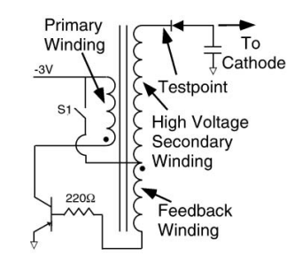
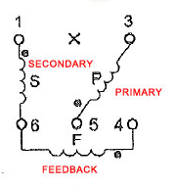
Voltage booster
C
0.3ms
B
E
20~30ms

Slide 20
Shopping list:

Slide 21
Website:
http://may1633.sd.ece.iastate.edu/index.html

