Slide 1
Senior Design Weekly Update
Group may1633
9/21/2015

Slide 2
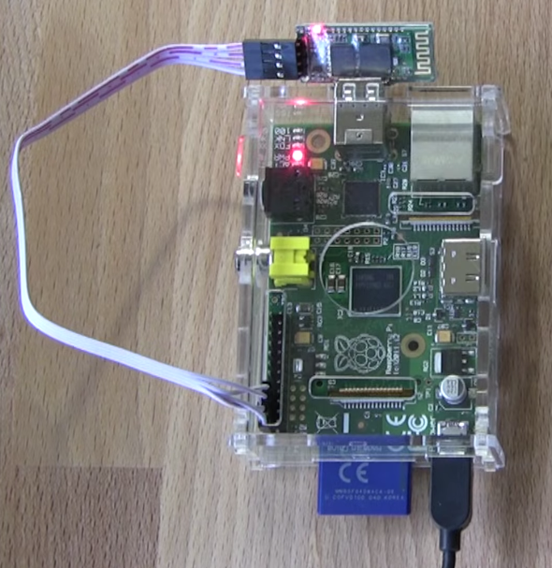
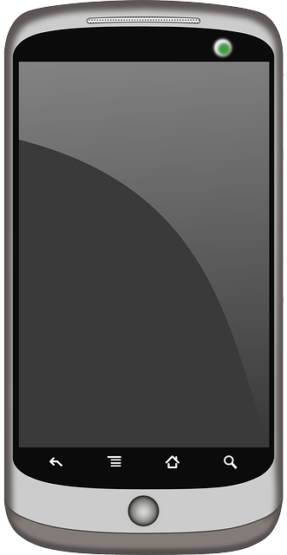
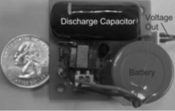
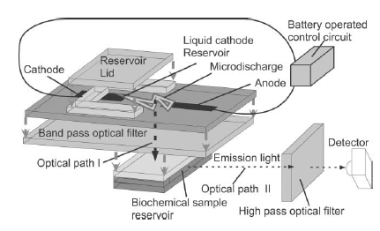
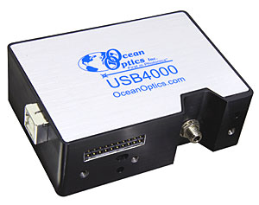
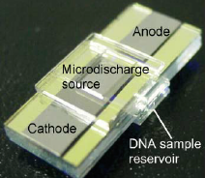
Conceptual sketch
Voltage Booster
Tutorial
Concentration
GPS
Figure
History
Microcontroller
Spectrometer
Android Application
Microdischarge Device
Haisong
Liuchang
Yang
Anthony
Tyler

Slide 3
Microdischarge device

Slide 4
Functional Requirements
Display levels of different elements in water sample with precision
Application is based on Android
The whole process should take less than 30s
Have database for the history
Have GPS for location information
Accurately distinguish between good/bad measurements
Transmit data wirelessly to smartphone

Slide 5
nonfunctional Requirements
Portable, low power and safe
Easy-use-interface. (tutorial, easy to find settings)
Be shielded from water and dirt damage
10ml water is acceptable amount to test with
Be able to remain powered wirelessly for 1000 trials
95% accurate with reading
Smartphone app size should be less than 6MB
Total time of analyzing water sample on smartphone application should take less than 30s
Communication from device to smartphone should take less than 2s
Wireless range should be up to 2m

