Slide 1
PORTABLE NUTRIENT DATA COLLECTION SYSTEM
Group: MAY1633
Advisors: Daji Qiao, Long Que
12/08/2015

Slide 2
Problem Statement
Managing nutrients in agriculture continues to be a major challenge in ecosystem science. In this project, we will design a portable system to address this problem using integrated MEMS micro plasma-based sensors and a spectrometer with a microcontroller to collect and transmit data wirelessly to a smartphone app with an easy-access interface.

Slide 3
Functional Requirement
The whole process should take less than 30s
Display concentration of different elements(N&P) in water sample with precision
Accurately distinguish between good/bad measurements
Transmit data wirelessly to smartphone
With water and soil proof
Application is based on Android
Have database for the history

Slide 4
Nonfunctional Requirement
1. Portable, low power and safe
2. Easy-use-interface. (tutorial, easy to find settings)
3. Be shielded from water and dirt damage
4. 10ml water is acceptable amount to test with
5. Be able to remain powered wirelessly for
1000 trials
6. 95% accurate with reading
7. Smartphone app size should be less than 6MB
8. Total time of analyzing water sample on smartphone application should take less than 30s
9. Communication from device to smartphone should take less than 2s
10. Wireless range should be up to 2m

Slide 5
Market Survey
Mi TDS Pen
Portable
Low Power
Water quality
No smartphone communication
Image: http://xiaomi-mi.com/mi-water/mi-tds-pen/
Labs
Works same as device
Not portable
No smartphone communication

Slide 6
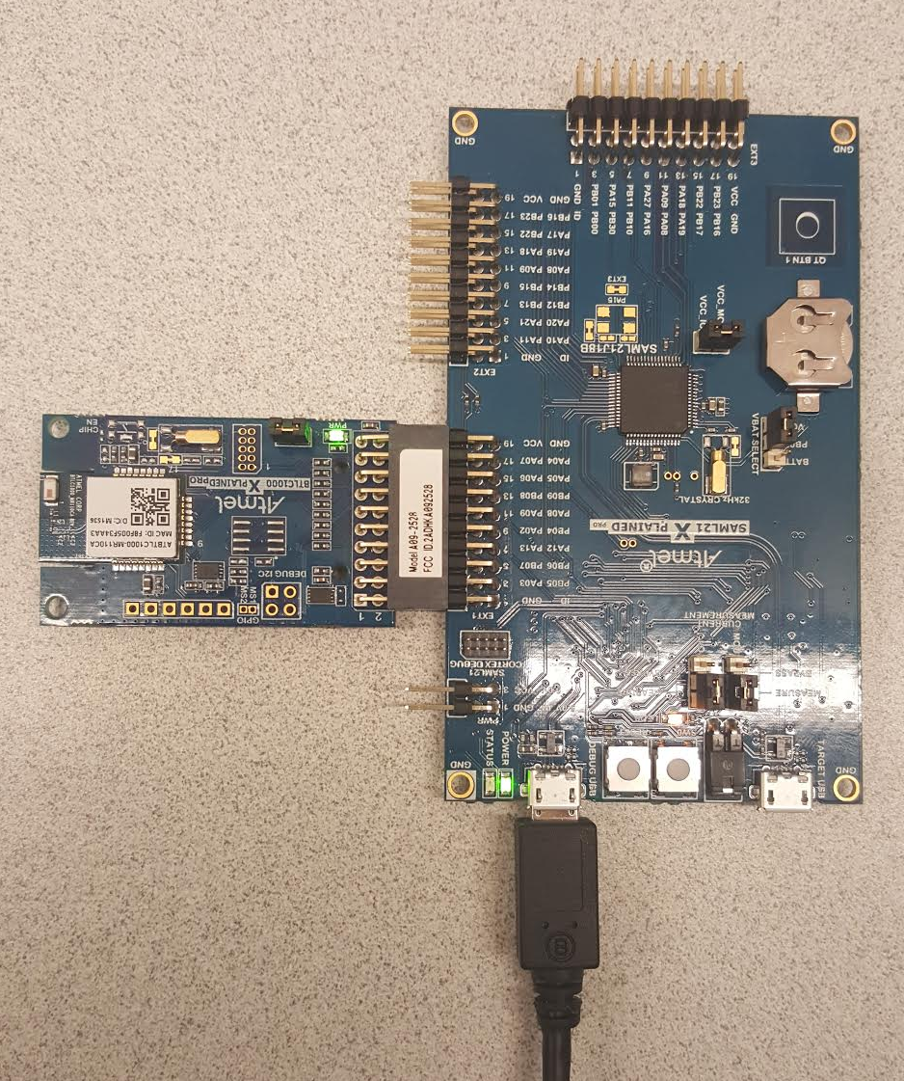
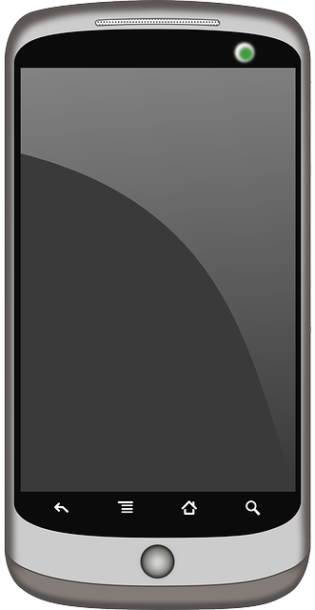
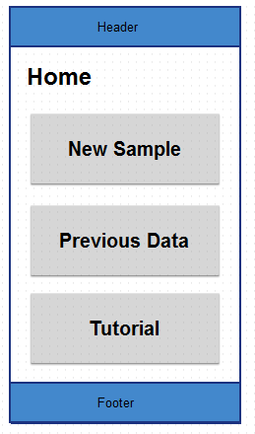
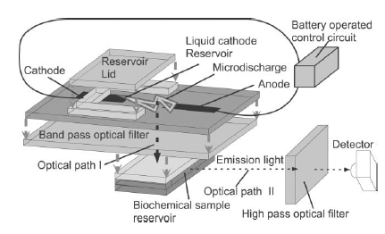
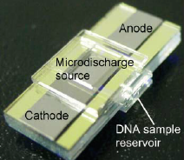
Conceptual Sketch
Microcontroller
User to device: Android device to microcontroller via Bluetooth
Start micro discharge device and voltage booster via microcontroller.
Send optical information from micro discharge device to spectrometer
Send spectrometer data to microcontroller
Display results on the android application
Voltage Booster
Android Application
Microdischarge Device
Spectrometer

Slide 7
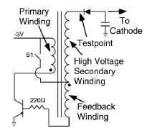
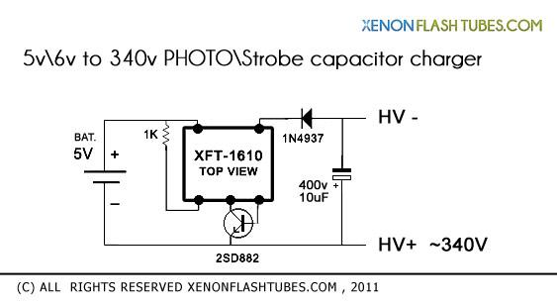
Voltage Booster

Slide 8
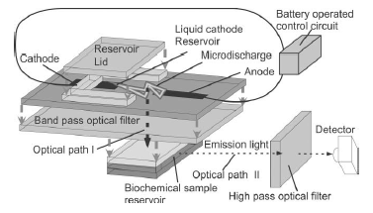
Micro-discharge Device

Slide 9
Interface Between Spectrometer and MCU

Slide 10
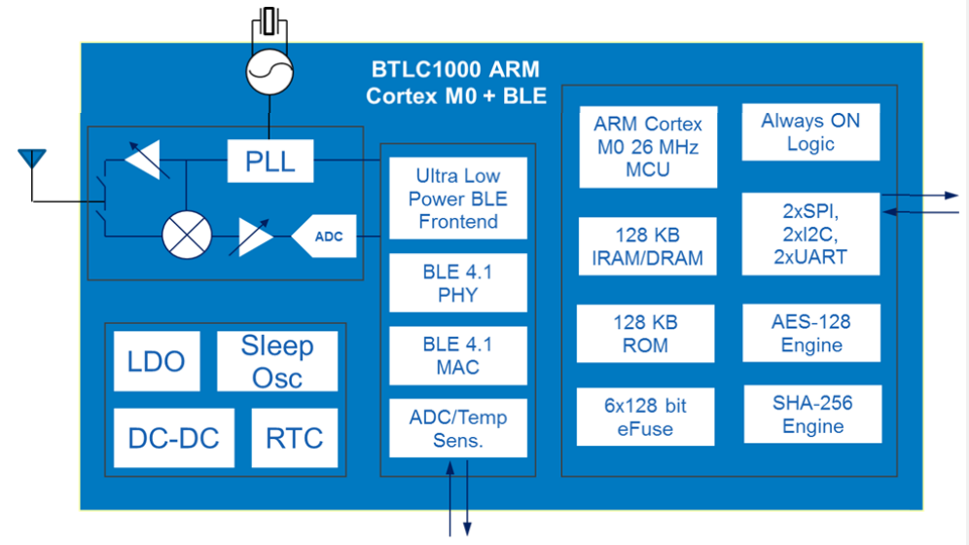
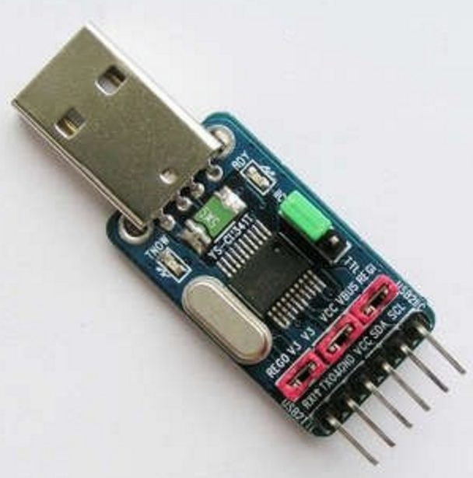
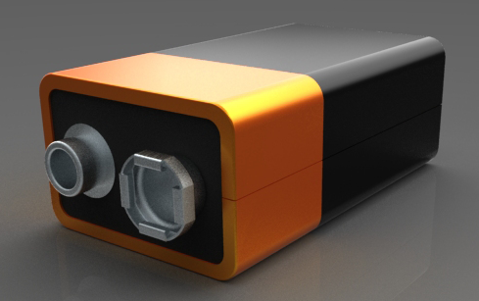
MCU Board Design
External Crystal
USB to UART adapter
UART_RxD
Bluetooth antenna
UART_TxD
Power source
9V Battery

Slide 11
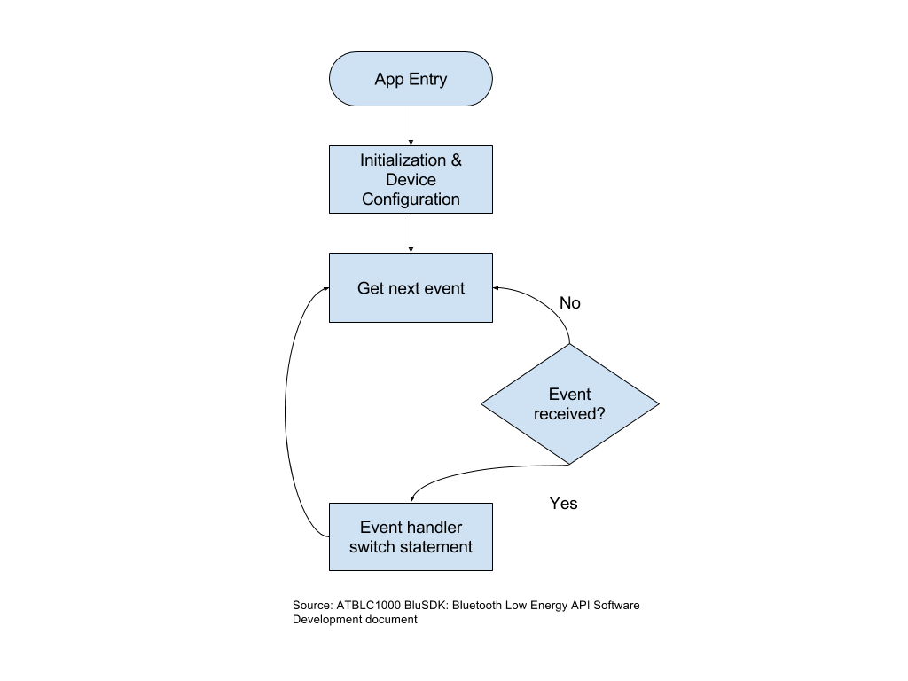
Android and Device Communication
Events:
User initiates bluetooth pairing
User initiates system start
MCU indicates process finished, data sent

Slide 12
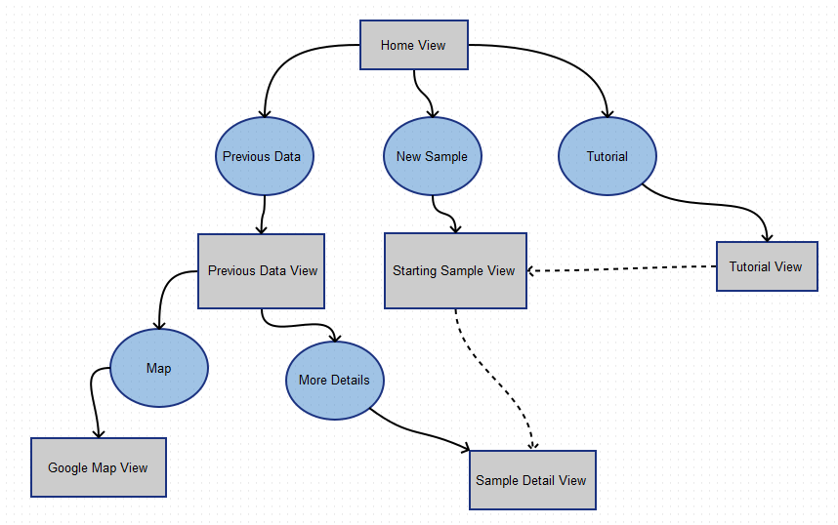
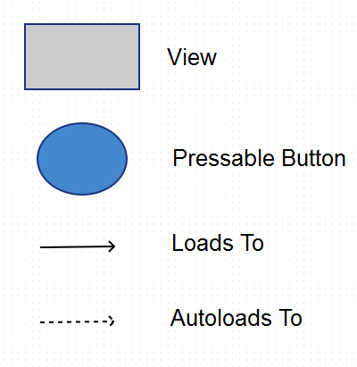
Screen Sketches

Slide 13
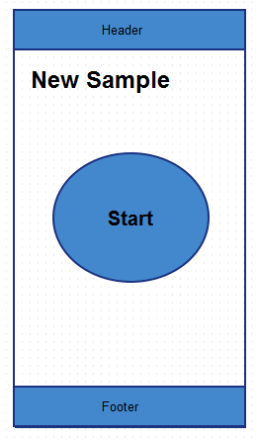
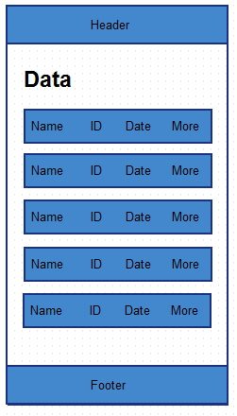
Screen Sketches

Slide 14
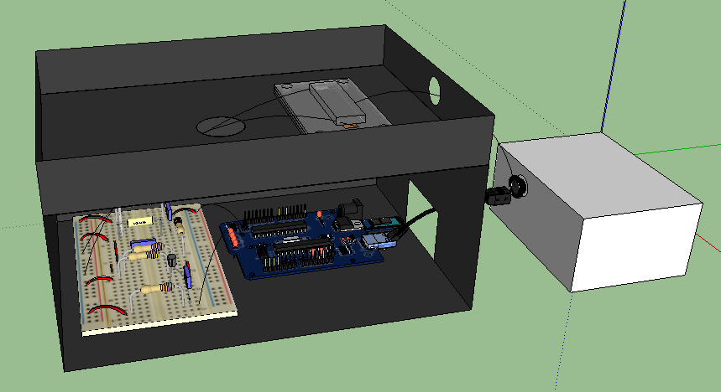
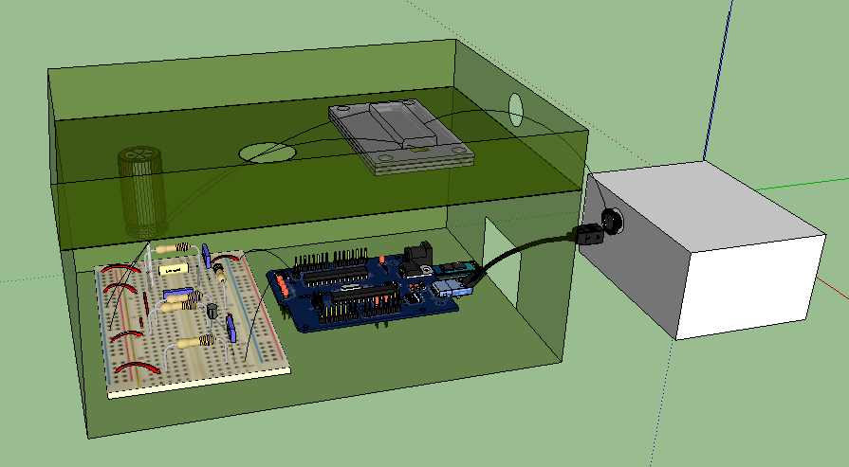
3-D View of the System

Slide 15
Approximate Costs
Item. | Qty. | Cost(each). | Part Description. | Supplier#.
1 | 2 | $108.26 | BLTC 1000Xplained pro starter kit | ATBTLC1000-XSTK
2 | 2 | $7.29 | 3v to 300v inverter transformer | Xft-5683-3v
3 | 1 | $10.08 | 6v to 340v inverter transformer | Xft-1610-6v
4 | 3 | $0.3 | Npn 30v 3a transisor | 2sd882
5 | 2 | $12.52 | 450v 1000ufcapacitor | C450-1000u
6 | 1 | ~ | Spectrometer | Ocean optics 4000
7 | 1 | ~ | 3D-printing case
Total |  | $267.12 | Whole system

Slide 16
Potential Risks
Timeline: Research project with many unknown factors, software installation issue, components debugging, etc.
Power Supply: Risk of burning the circuit.
Data Transfer and formatting.

Slide 17
Technical Consideration
The customized spectrometer may have connection issue with microcontroller
Loading the water sample manually may limit the application of this device
The size of the device is not small enough
300v boosted voltage pulse may hurt people
GPS and LCD screen may be needed to improve functionality of system

Slide 18
Test Plan
Voltage booster circuit: test the amplification factor.
Micro-discharge device: test the fluorescent stimulation ability.
Spectrometer: test the precision and communication to microcontroller.
Microcontroller: test PCB board has Bluetooth and MCU communication.
Device and Smartphone communication: test smartphone control and data acquisition.
Smartphone application: usability test (surveys), functionality test.

Slide 19
Current Project Status
Voltage booster: testing circuits
Microcontroller board: testing the schematic diagram, doing the PCB design
Spectrometer to evaluation board: building the connection between spectrometer and evaluation board
Smartphone: starting to communicate with our test microcontroller, and beginning to build the screens for app

Slide 20
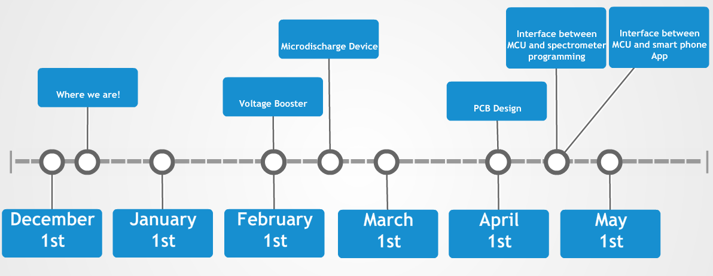
Plan for Next Semester

Slide 21
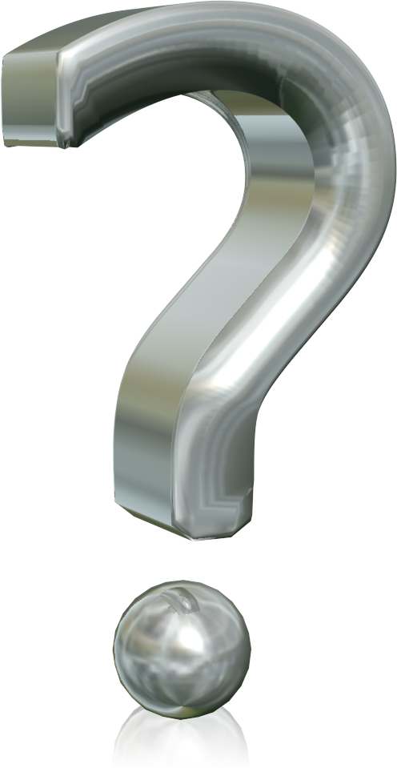
Questions

